Slide 1

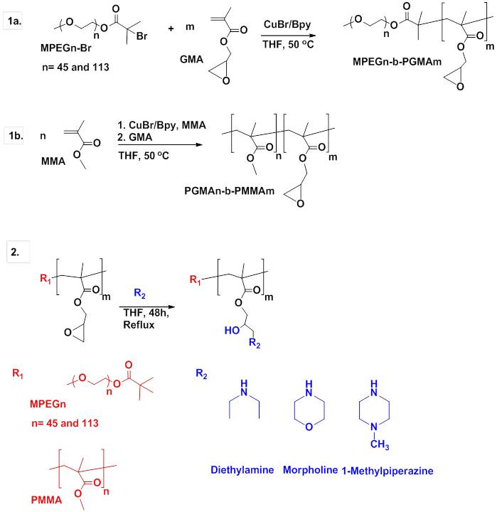
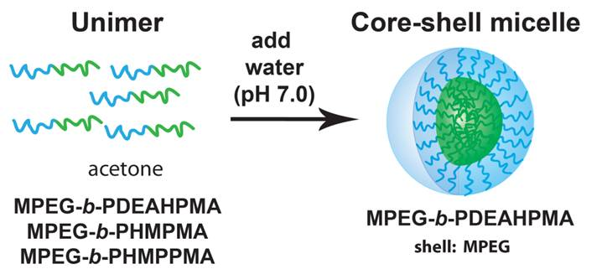
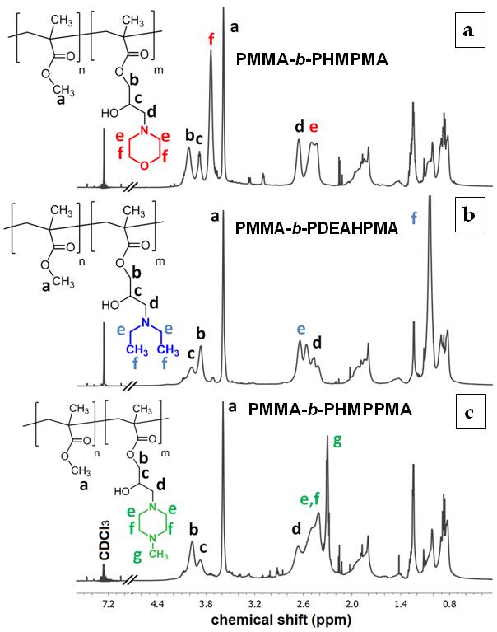
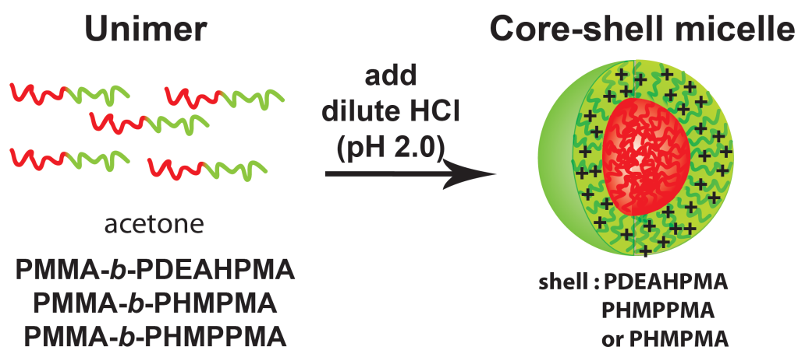
FES2108
Novel surface active (co)polymers
from glycidyl methacrylate-based polymers and their self-assembly behaviors
Vural BUTUN^{1,*}, Gokhan KOCAK¹, Gokhan SOLMAZ² , Zeynep DIKMEN²
and Cansel TUNCER¹
¹ Department of Chemistry, Eskisehir Osmangazi University, Eskisehir 26480, Turkey
² Department of Polymer Science and Technology, Eskisehir Osmangazi University, Eskisehir 26480, Turkey
PGMA Based (Co)Polymers
Table 1. Unimer/micelle/aggregate behaviors of PMMA-b-PDEAHPMA, PMMA-b-PHMPMA and PMMA-b-PHMPPMA block copolymers in aqueous media by using acetone (acetone/water: 1/5 v/v ) at 25 ºC and at pH 2..
This study reports the synthesis of poly(glycidyl methacrylate) based block copolymers and their derivatisations with morpholine, 1-methylpiperazine and diethyl amine. These copolymers have response to external stimuli that makes them water soluble and surface active.
Polymer | Conc.: 10 g L⁻¹ | Conc.: 5 g L⁻¹
 | R_{h} /𝜇₂/Γ² | R_{h} /𝜇₂/Γ²
PMMA_{0.46}-b-PHMPMA_{0.54} | unimer | unimer
PMMA_{0,40}-b-PHMPMA_{0,60} | 100 / 0.13 | 27 / 0.32
PMMA_{0,47}-b-PHMPMA_{0,53} | 117 / 0.06 | 108 / 0.08
PMMA_{0,36}-b-PHMPMA_{0,64} | 127 / 0.04 | 82 / 0.07
PMMA_{0,46}-b-PHMPPMA_{0,54} | 52 / 0.08 | 51 / 0.09
PMMA_{0,40}-b-PHMPPMA_{0,60} | 55 / 0.11 | 41 / 0.20
PMMA_{0,47}-b-PHMPPMA_{0,53} | 99 / 0.12 | 83 / 0.09
PMMA_{0,36}-b-PHMPPMA_{0,64} | 178 / 0.07 | 128 / 0.14
PMMA_{0,46}-b-PDEAHPMA_{0,54} | 80 / 0.12 | 73 / 0.16
PMMA_{0,40}-b-PDEAHPMA_{0,60} | 98 / 0.11 | 28 / 0.38
PMMA_{0,47}-b-PDEAHPMA_{0,53} | 112 / 0.01 | 79 / 0.02
PMMA_{0,36}-b-PDEAHPMA_{0,64} | 224 / 0.06 | 186 / 0.02
Related MPEG-b-PHMPMA and MPEG-b-PMPPMA polymers formed aggregates (R_{h}> 200 nm) in aqueous media and MPEG-b-PDEAHPMA copolymers formed core-shell micelles (R_{h} 20-30 nm).
Style
Figure 1. Synthetic route for the synthesis of (1a) MPEG_{n}–b-PGMA block copolymer, (1b) PMMA-b-PGMA block copolymer and (2) modification of PGMA block.
Figure 4. Schematic representation of micellisation of block copolymers in aqueous media.
Table 2. Micelle/aggregate formations of MPEG-b-PDEAHPMA, MPEG-b-PHMPMA and MPEG-b-PHMPPMA block copolymers in aqueous media at different pHs, Na₂SO₄ concentrations and temperatures.
Polymer | Conc. (gL⁻¹) | pH 2.0 25 ºC | pH 10.5 25 ºC | pH 10.5 0.25 M Na₂SO₄ | pH 10.5 0.5 M Na₂SO₄
 |  | R_{h} / 𝜇₂/Γ² | R_{h} / 𝜇₂/Γ² | R_{h} / 𝜇₂/Γ² | R_{h} / 𝜇₂/Γ²
MPEG₄₅-b-PDEAHPMA₄₅ | 10 | Unimer | 23 / 0.10 | - | -
MPEG₄₅-b-PDEAHPMA₆₃ | 10 | Unimer | 24 / 0.10 | - | -
MPEG₄₅-b-PHMPMA₄₅ | 3 | Unimer | Unimer | 250 / 0.74 55 ºC | 517 / 0.33 29 ºC
MPEG₄₅-b-PHMPMA₆₃ | 3 | Unimer | Unimer | 419 / 0.12 51 ºC | 496 / 0.89 33 ºC
MPEG₄₅-b-PHMPMA₈₃ | 3 | Unimer | Unimer | 395 / 0.12 48 ºC | 1323/0.12 25 ºC
MPEG₄₅-b-PHMPPMA₅₂ | 3 | Unimer | Unimer | 428 / 0.58 50 ºC | 225 / 0.53 24 ºC
MPEG₄₅-b-PHMPPMA₆₃ | 3 | Unimer | Unimer | - | 223 / 0.08 43 ºC
MPEG₄₅-b-PHMPPMA₈₃ | 3 | Unimer | Unimer | - | 663 / 0.72 28 ºC
Printing
Conclusions
Most important outcomes of these block copolymers: They can be used as stabilisers in heterogeneous polymerisations (i), sources for novel cross-linked micelles by reacting functional groups of micelle core or corona with bifunctional cross-linker (ii), stabiliser in the production of metal nanoparticle dispersions (iii), etc.
Due to having stimuli-responsive nature and a number of functional groups, these block copolymers are promising great potentials for various applications such as in the preparation of microgels, latexes, cross-linked micelles, pickerers, hydrogels, flocculants, nanometal-polymer hybrid systems/composites/nanocatalyst systems, and other different polymeric and/or polymer containing composite materials.
They are getting more and more attention for various applications such as biotechnology (as antibacterial agents, drug carriers, controlled releasing systems etc), in sensor technology, in cosmetics...
Figure 2. ¹H NMR spectra of
PMMA-b-PHMPMA, b) PMMA-b-PDEAHPMA and
c) PMMA-b-PHMPPMA diblock copolymers (in CDCl₃).
Solution Behaviours
All resulting (co)polymers can self-assemble in aqueous media and form core-shell spherical micelles depending on solution conditions due to one block having stimuli responsive nature. Their responses to temperature, salt and pH were determined in aqueous media.
Figure 3. Schematic representation of the micellisation of block copolymers in aqueous media.

